Slide 1
Recommend a Text Classification Dataset
范哲豪 104403011
吳謦廷 104403044

Slide 2
Find a "standardized" text classification dataset

Slide 3
2225
Documents from the BBC news website (2004-2005)
Includes business, entertainment, politics, sport, tech.

Slide 4
Yukos unit buyer faces loan claim. The owners of embattled Russian oil giant Yukos are to ask the buyer of its former production unit to pay back a $900m (£479m) loan. State-owned Rosneft bought the Yugansk unit for $9.3bn in a sale forced by Russia to part settle a $27.5bn tax claim against Yukos. Yukos' owner Menatep Group says it will ask Rosneft to repay a loan that Yugansk had secured on its assets. Rosneft already faces a similar $540m repayment demand from foreign banks. Legal experts said Rosneft's purchase of Yugansk would include such obligations. "The pledged assets are with Rosneft, so it will have to pay real money to the creditors to avoid seizure of Yugansk assets," said Moscow-based US lawyer Jamie Firestone, who is not connected to the case. Menatep Group's managing director Tim Osborne told the Reuters news agency: "If they default, we will fight them where the rule of law exists under the international arbitration clauses of the credit."Rosneft officials were unavailable for comment. But the company has said it intends to take action against Menatep to recover some of the tax claims and debts owed by Yugansk. Yukos had filed for bankruptcy protection in a US court in an attempt to prevent the forced sale of its main production arm. The sale went ahead in December and Yugansk was sold to a little-known shell company which in turn was bought by Rosneft. Yukos claims its downfall was punishment for the political ambitions of its founder Mikhail Khodorkovsky and has vowed to sue any participant in the sale.

Slide 5
WHY we recommend this dataset?
15

Slide 6




Hiiii everyone! My dream is to have passionate sex with Katy Perry. Sex is a giant part of my life and it pushes me to be a better person! If you love my ambition please SUBSCRIBEEE!??? <3
YOU HAVE WON! As a valued Vodafone customer our computer has picked YOU to win a ?50 prize. To collect is easy. Just call 09061743386
Ill call u 2mrw at ninish, with my address that icky American freek wont stop callin me 2 bad Jen k eh?
THIS IS SHIT AND SOOOOO AUTOTUNED???

Slide 7
YouTube & SMS
vs
BBC News
Vectorization
Stem words & Stop words
N-gram model
Efficiency of data processing

Slide 8
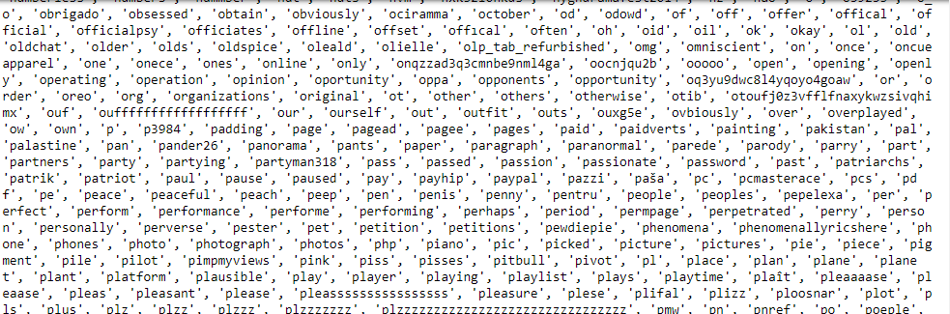
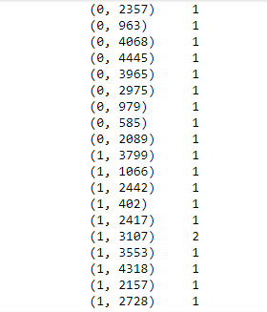
Vectorization Results (YouTube)
countVectorizer.get_feature_names()
countVectorizer.fit

Slide 9
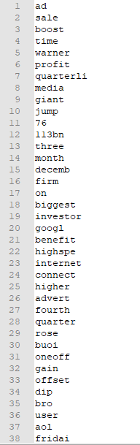
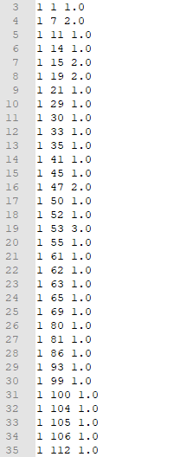
Vectorization Results (BBC)

Slide 10

N-gram model
N=2
N=3

Slide 11
Feature and Statistics
Stop words: about, among, and, end, hour, ourselves, therefore, whether, why, within, where.

Slide 12
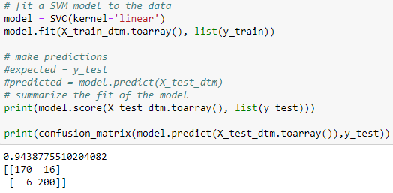
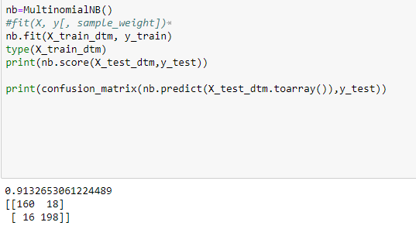
Naïve bayes
Description of Classification Task
SVM

Slide 13
Reference
Almeida, Gómez, and Yamakami, “Contributions to the Study of SMS Spam Filtering: New Collection and Results.”
Hidalgo, Almeida, and Yamakami, “On the Validity of a New SMS Spam Collection.”

Slide 14
Q & A
Recommend a Text Classification Dataset
吳謦廷 范哲豪

Slide 15
Thank you
Recommend a Text Classification Dataset
吳謦廷 范哲豪
Notes:
掃地機器人~~~走路比較

